Slide 1
Internet of Things Using Node-Red and Alexa
AnOJA rajalakshmi
School of engineering

Slide 2
What is IoT?
Internet of Things (IoT) means learning and interacting with millions of things including services, sensors, actuators, and many other objects on the Internet.
IoT allows objects to be sensed and controlled remotely across networks.
Notes:
Things are wide variety of devices like Wifi connected or has access to internet

Slide 3
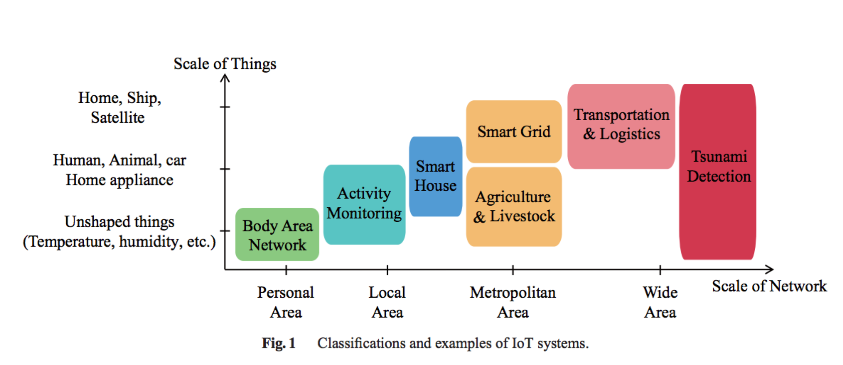
IoT Classification
Image Courtesy: Yuichi Kawamoto, Hiroki Nishiyama, Nei Kato, Naoko Yoshimura, and Shinichi Yamamoto, "Internet of Things (IoT): Present State and Future Prospects", IEICE Transactions on Information and Systems, Oct. 2014
Notes:
Body Area Network: Wearables, Implants,
Activity Monitoring: ECG, Tilt Sensor, Motion Sensors
Smart House: Smoke sensor, Smart window, Gas leak sensor, Camera
Agriculture: Smart sprinklers, pest control monitors, drones for field monitoring
Livestock: sensors on animals to monitor their health
Transportation: lost/stolen car tracking, smart parking

Slide 4
Evolution of Human Machine Interaction
1. Screen and Keyboard, Text-bases UI computers.
Notes:
Through monitors, people can read the outputs from computers.
The input is captured by keyboards, which is the only way.
And the “Computers” act in the middle to carry out calculation or simply do the tasks given

Slide 5
2. Mouse, GUI computers
Notes:
A computer mouse is a pointing device (hand control) that detects two-dimensional motion relative to a surface. This motion is typically translated into the motion of a pointer on a display, which allows a smooth control of the graphical user interface.

Slide 6
3. Touch Screen, Portable devices.
Notes:
A touchscreen is an input and output device normally layered on the top of an electronic visual display of an information processing system. A user can give input or control the information processing system through simple or multi-touch gestures by touching the screen with a special stylus and/or one or more fingers

Slide 7
4. Voice-control
Notes:
Voice control on smart phones: Siri, Cortana
Google home: Hands-free help from the Google Assistant
Amazon Voice service called Alexa inside Echo, Echo Dot,

Slide 8
Applications of Voice Control and IoT
Control of Home devices
Outdoor
Security
Weather Monitoring
Navigation
Industrial automation
Notes:
We can create customized skills or voice commands which can be used in day today basic.
The reason for customized skill is that need for each individual may vary. Suppose if one likes watching news in the morning, other might prefer radio or a newspaper. So we can create our own skills to make our life easy.

Slide 9
Lets get into the project
Hardware:
MCUs: Raspberry Pi, Intel Edison, ESP8266, ESP32
Sensors: Photo Light Sensor, DHT11(Temp/Humidity), PIR, Door Sensor, Seed groove kit
Actuators: Servo Motor, LED, Relays, Buzzer
Hands free speaker: Amazon Echo
Web Services:
Alexa Skill Kit
Amazon Web Services(AWS)
IBM Bluemix
Twilio
Third party services: Open weather, Google account for email, Mosquitto
Protocols:
MQTT
HTTP
SSH

Slide 10
Raspberry Pi 3 Model B
BCM43438 wireless LAN and Bluetooth Low Energy (BLE) on board
Quad Core 1.2GHz Broadcom BCM2837 64bit CPU
Features: GPIO, UART, I2C and SPI
1GB RAM
40-pin extended GPIO
4 USB 2 ports
Runs Linux and Node RED

Slide 11
Intel Edison
Processor: 22 nm Intel® SoC that includes a dual-core, dual-threaded Intel® Atom™ CPU at 500 MHz and a 32-bitIntel® Quark™ microcontroller at 100 MHz
RAM: 1 GB
Wireless: Dual-band (2.4 and 5 GHz) IEEE 802.11a/b/g/n
40 general purpose GPIO features:
SD card: 1 interface
UART: 2 controllers
I2C: 2 controllers
SPI: 1 controller with 2 chip selects
I2S: 1 controller
GPIO: Additional 14 (with 4 capable of PWM)

Slide 12
ESP8266
Low-cost microcontroller including full TCP/IP stack
Produced by Shanghai-based Chinese manufacturer, Espressif Systems.
CPU: 32-bit RISC Tensilica Xtensa L106 @ 80 MHz.
RAM: 64 kB for instructions; 96 kB of data.
WiFi: IEEE 802.11 b/g/n – WEP or WPA/WPA2 authentication, or open networks.
Features: 16 GPIO pins, SPI, I2C, UART, 10-bit ADC.
Slide Courtesy: https://github.com/apuder/iot-workshop/blob/master/doc/iot-workshop-slides.pdf

Slide 13
ESP32
CPU: 240 MHz dual core Tensilica LX6 microcontroller with 600 DMIPS
Integrated 520 KB SRAM
Robust Design: industrial environments with an operating temperature ranging from -40°C to +125°C
2.4 GHz Wi-Fi and Bluetooth combo chip
Ultra-Low Power Management
Features:
3 x UARTs
3 x SPI
2 x I2S
12 x ADC input channels
2 x DAC
2 x I2C
PWM/timer input/output available on every GPIO pin

Slide 14
SENSORS
Notes:
DHT11 – Temparature/ humidity sensor
Door Sensor - one reed switch and one magnet, creating a closed circuit. If someone opens an armed door or window, the magnet is pulled away from the switch, which breaks the circuit and triggers an event.
Ultrasonic sensor – Detects the distance between objects
PIR – Passive Infrared Sensor 120 degree
Photo light sensor- resistance decrease when exposed exposed to light

Slide 15
ACTUATORS
Notes:
LEDs are the easiest way to simulate an output

Slide 16
Working of LED
Pin D2 is in output mode.
Whenever Microcontroller turns pin D2 high, LED glows.
This process can be controlled from a remote location using different techniques.
LED can be replaced by a Relay which acts like a switch
Notes:
The important matter is getting the pin high or low according to our application.

Slide 17
Working of Relay
Pin D4 is in output mode
Relay pins:
Vcc: connected to 3V3 of NodeMCU
Gnd: connected to GND of NodeMCU
Signal: connected to Pin D4
NO/NC: Normally open/close (Output)
C: Common (Output)
Output can be connected to higher voltage up to 250V.
Notes:
Reason: Limitation of demo –ing garage door open and other lights

Slide 18
MQTT
Message Queuing Telemetry Transport is a lightweight publish/subscribe protocol with reliable bi-directional message delivery.
Invented in 1999 by Andy Stanford-Clark (IBM) and Arlen Nipper. The original problem was to send sensor data from oil pipelines through a satellite link.
Runs on top of TCP/IP. Both client and broker need a TCP/IP stack.
Event oriented, therefore avoids polling
Notes:
As you see I have listed about 4 different microcontrollers those can be placed anywhere in the world, They need a simple protocol to talk to each other.
This project uses MQTTfx for debugging MQTT messages.
MQTT.fx is a MQTT Client written in Java based on Eclipse Paho.

Slide 19
Publish / Subscribe
Clients are always connected with a broker.
Both publishers and subscribers are “clients”.
A client sends a message (publisher).
One or more clients receive the message (subscribers).
MQTT uses “topics” to determine which message is routed to which client.
A topic is a “hierarchical structured string”.
Notes:
All the red and blue are clients.
The client that publishes is called publisher.
All those receives is called subscribers
Topic is a string word and is hierarchical meaning: home -> living room ->light or home -> living room -> TV will be represented as /home/livingroom/light or home/livingroom/TV

Slide 20
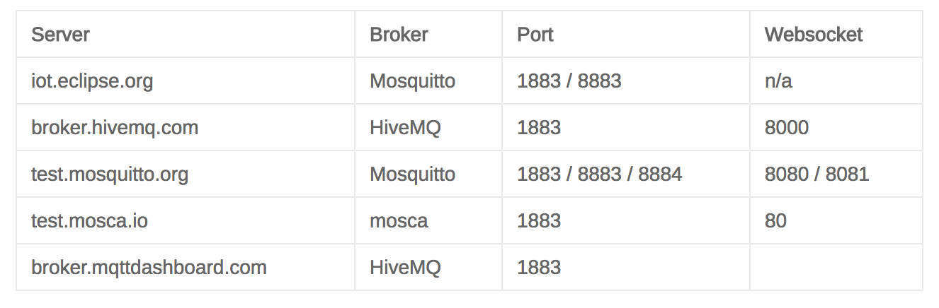
MQTT Broker
Source: http://moxd.io/2015/10/public-mqtt-brokers/

Slide 21
Advantages of EC2
Affordable/ Inexpensive – Free trial for an year
Capability of running thousands of instances at a time
Highly Secured- Includes web service interfaces to configure firewall settings that control network access to and between groups of instances

Slide 22
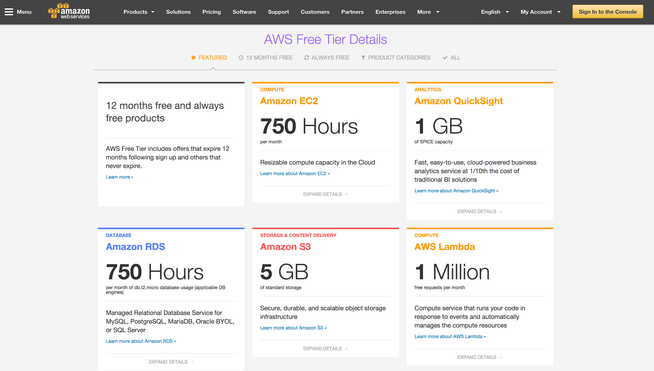

Slide 23
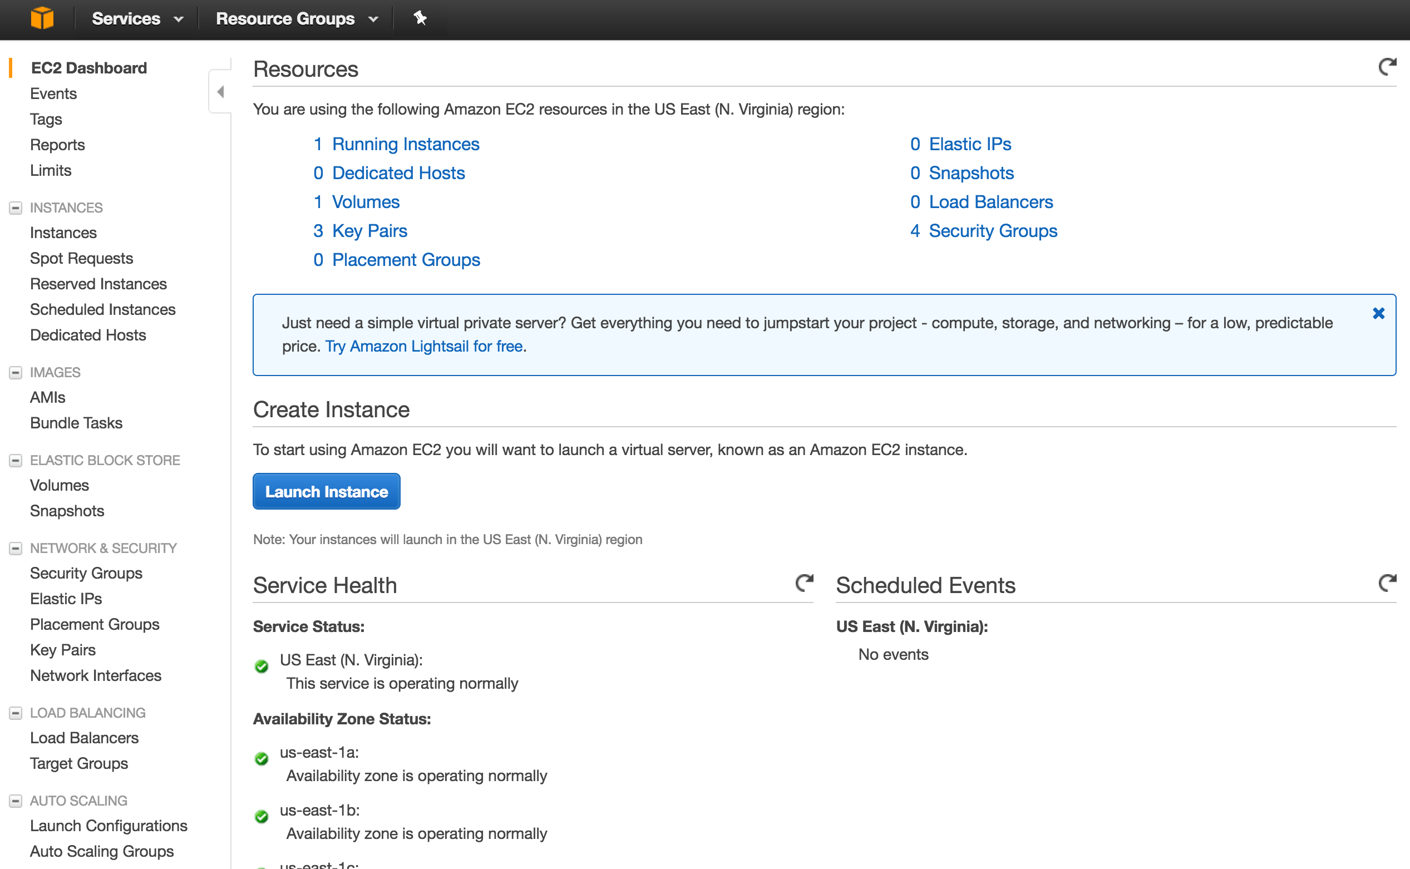

Slide 24
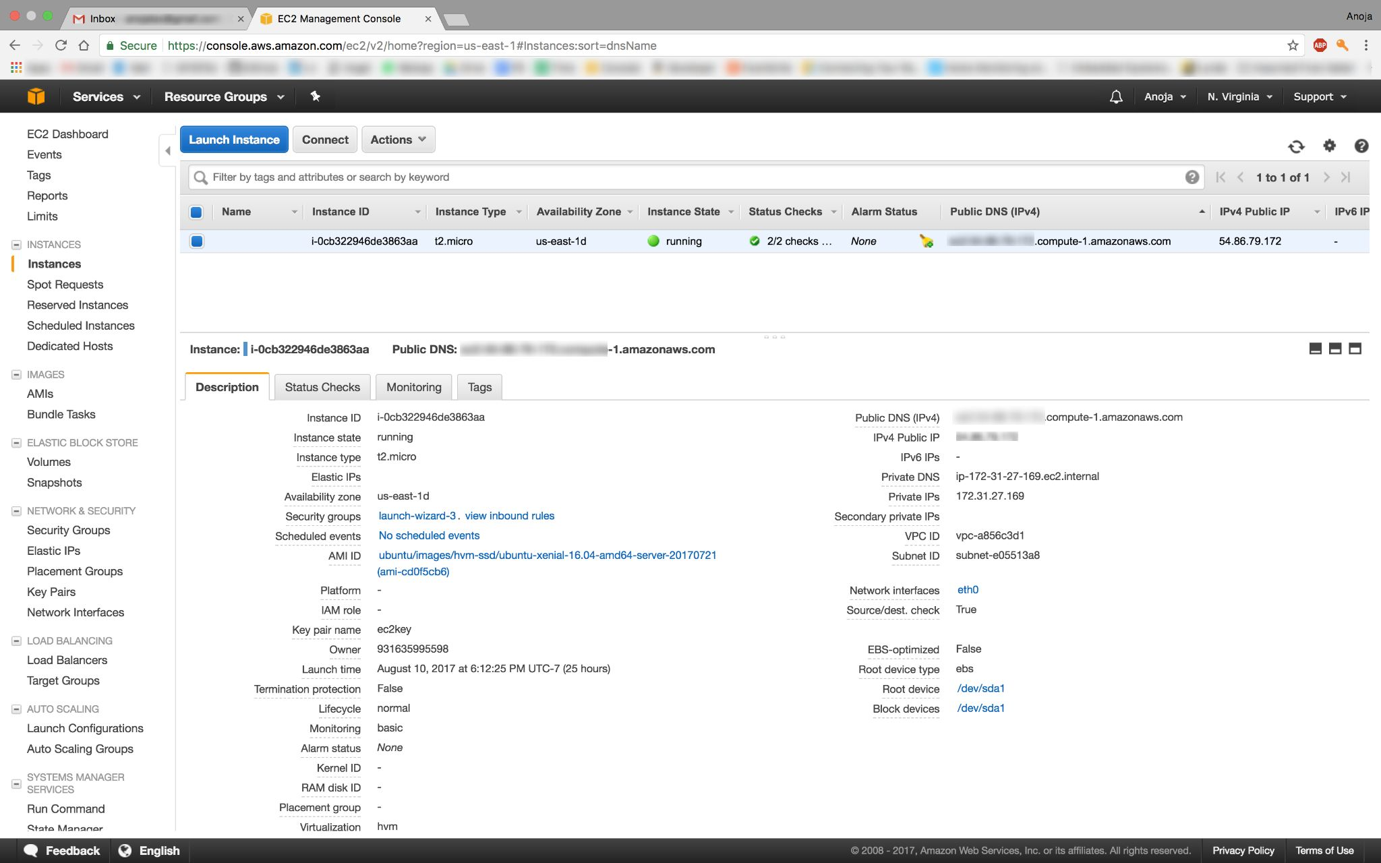

Slide 25
Alexa
Echo is powered by Alexa
Helps interact with devices in more intuitive way using voice
Developed by Amazon
When you ask Alexa for something, it triggers an Alexa Skills Kit, which is often linked to AWS Lambda to execute the code.
Courtesy: https://www.leverege.com/blogpost/alexa-skills-kit-tutorial

Slide 26
Basic Examples
Alexa, What is the weather today?
Alexa, trigger find my phone
Alexa, open demo
Notes:
Project Demo: The project aims to control and automate devices using voice. The major advantage of the system is ease of management for the user by not to have his or her phone open and click on certain options to control things or go near the switch to turn it on.

Slide 27
Node-RED
Node-RED is a software tool for wiring together hardware devices, APIs and online services as a part of IoT
Node-RED provides a browser-based flow editor, which can be used to create JavaScript functions.
Elements of applications can be saved or shared for re-use.
The runtime is built on Nodejs.
The flows created in Node-RED are stored using JSON.

Slide 28
Flow in Intel Edison
Notes:
Node Red makes it easy to change a decision.
In the first flow, A photo light sensor input is send to a regulator that decides whether to on or off the relay board.
Assume that relay board has connection to a light switch.
The average reading of Photo sensor in this room is 4 lux (luminous flux per unit area). Regulator is set to 2. Lets change the value to 6 and see difference.
I am opening node red in Edison using SSH.
This will help us not to remove the device installed and update code inside.

Slide 29
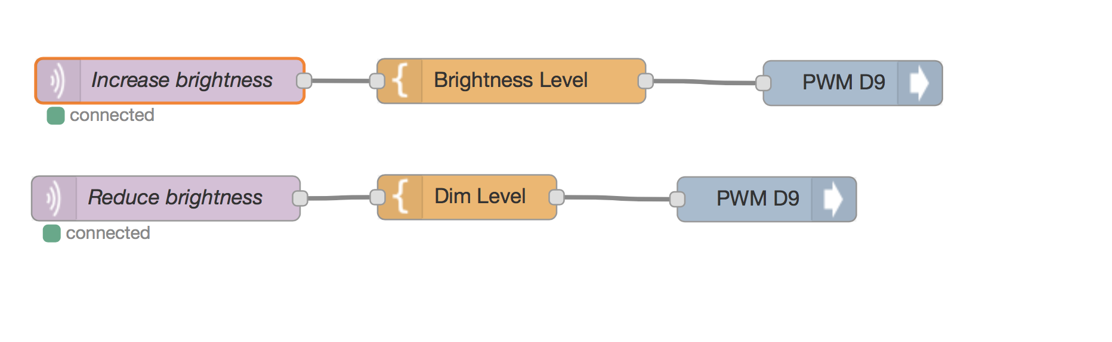
Notes:
For this flow the command comes from alexa.
Lets try that:
Alexa, ask demo to increase the brightness
Alexa, Ask demo to reduce the brightness

Slide 30
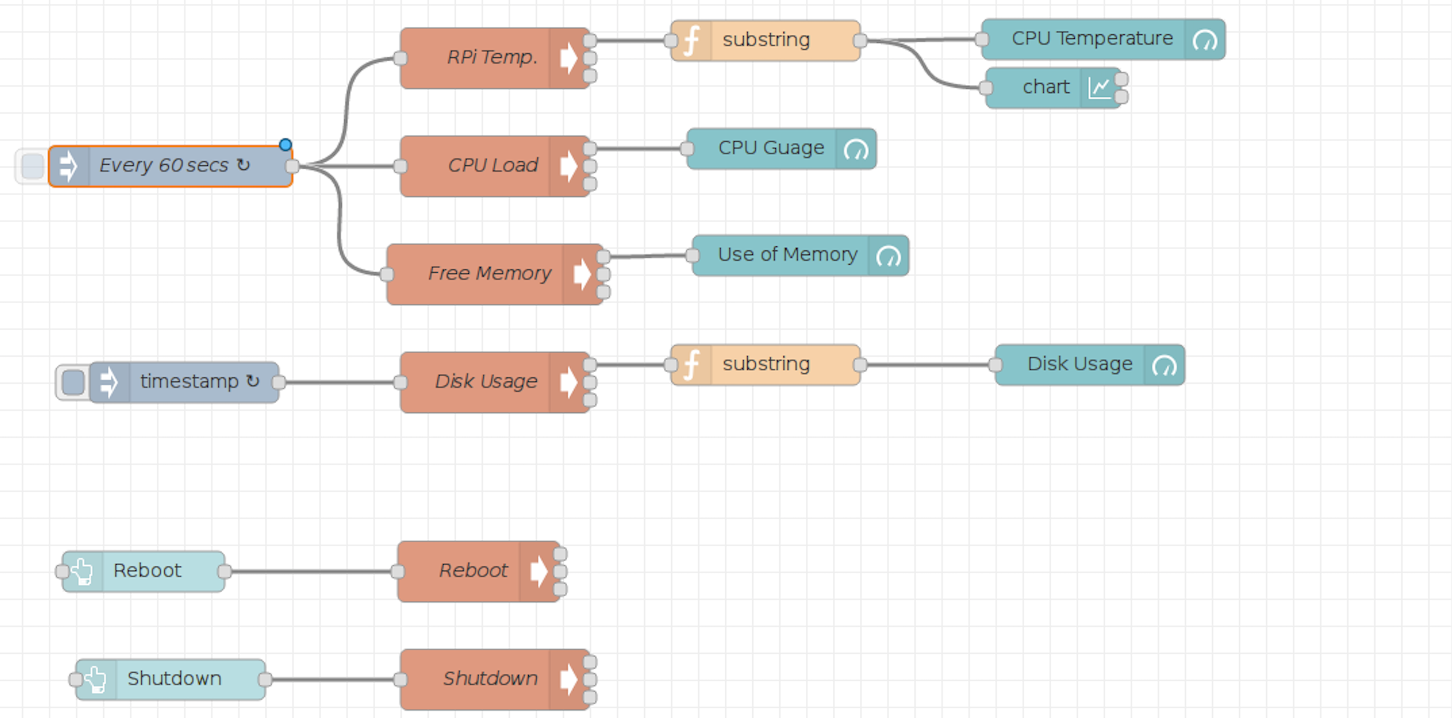
Flow in RPi

Slide 31
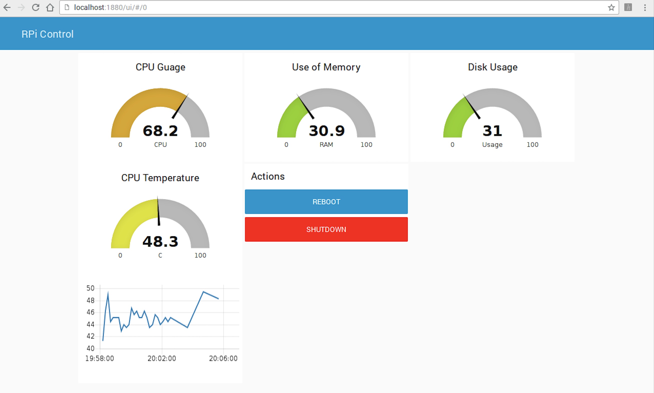
Dashboard for Pi

Slide 32
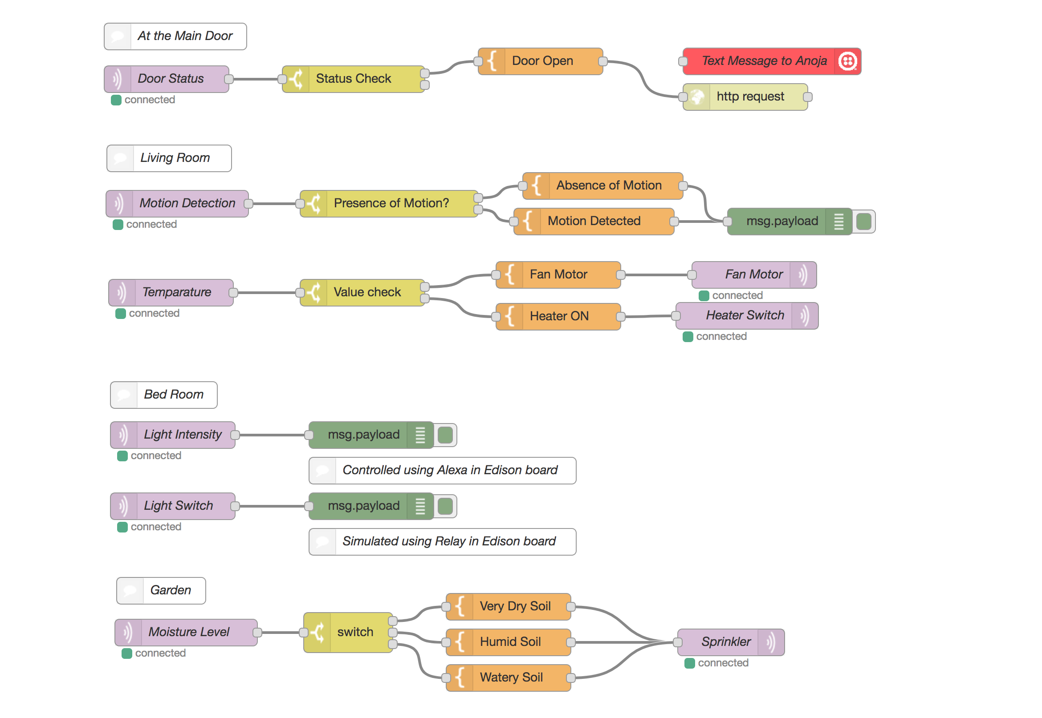
Master Control Flow in Raspberry Pi
Notes:
We have all the sensor input in the raspberry Pi. We could control any device in any iot devices connected to the cloud. This flow runs in the local server and is accessible only for this raspberry pi.

Slide 33
Flow in IBM BlueMix
Notes:
The flow we discussed before can be moved to the cloud. IBM Bluemix provide a platform that runs node red. This will help us control all these devices including node red from any part of the world.

Slide 34
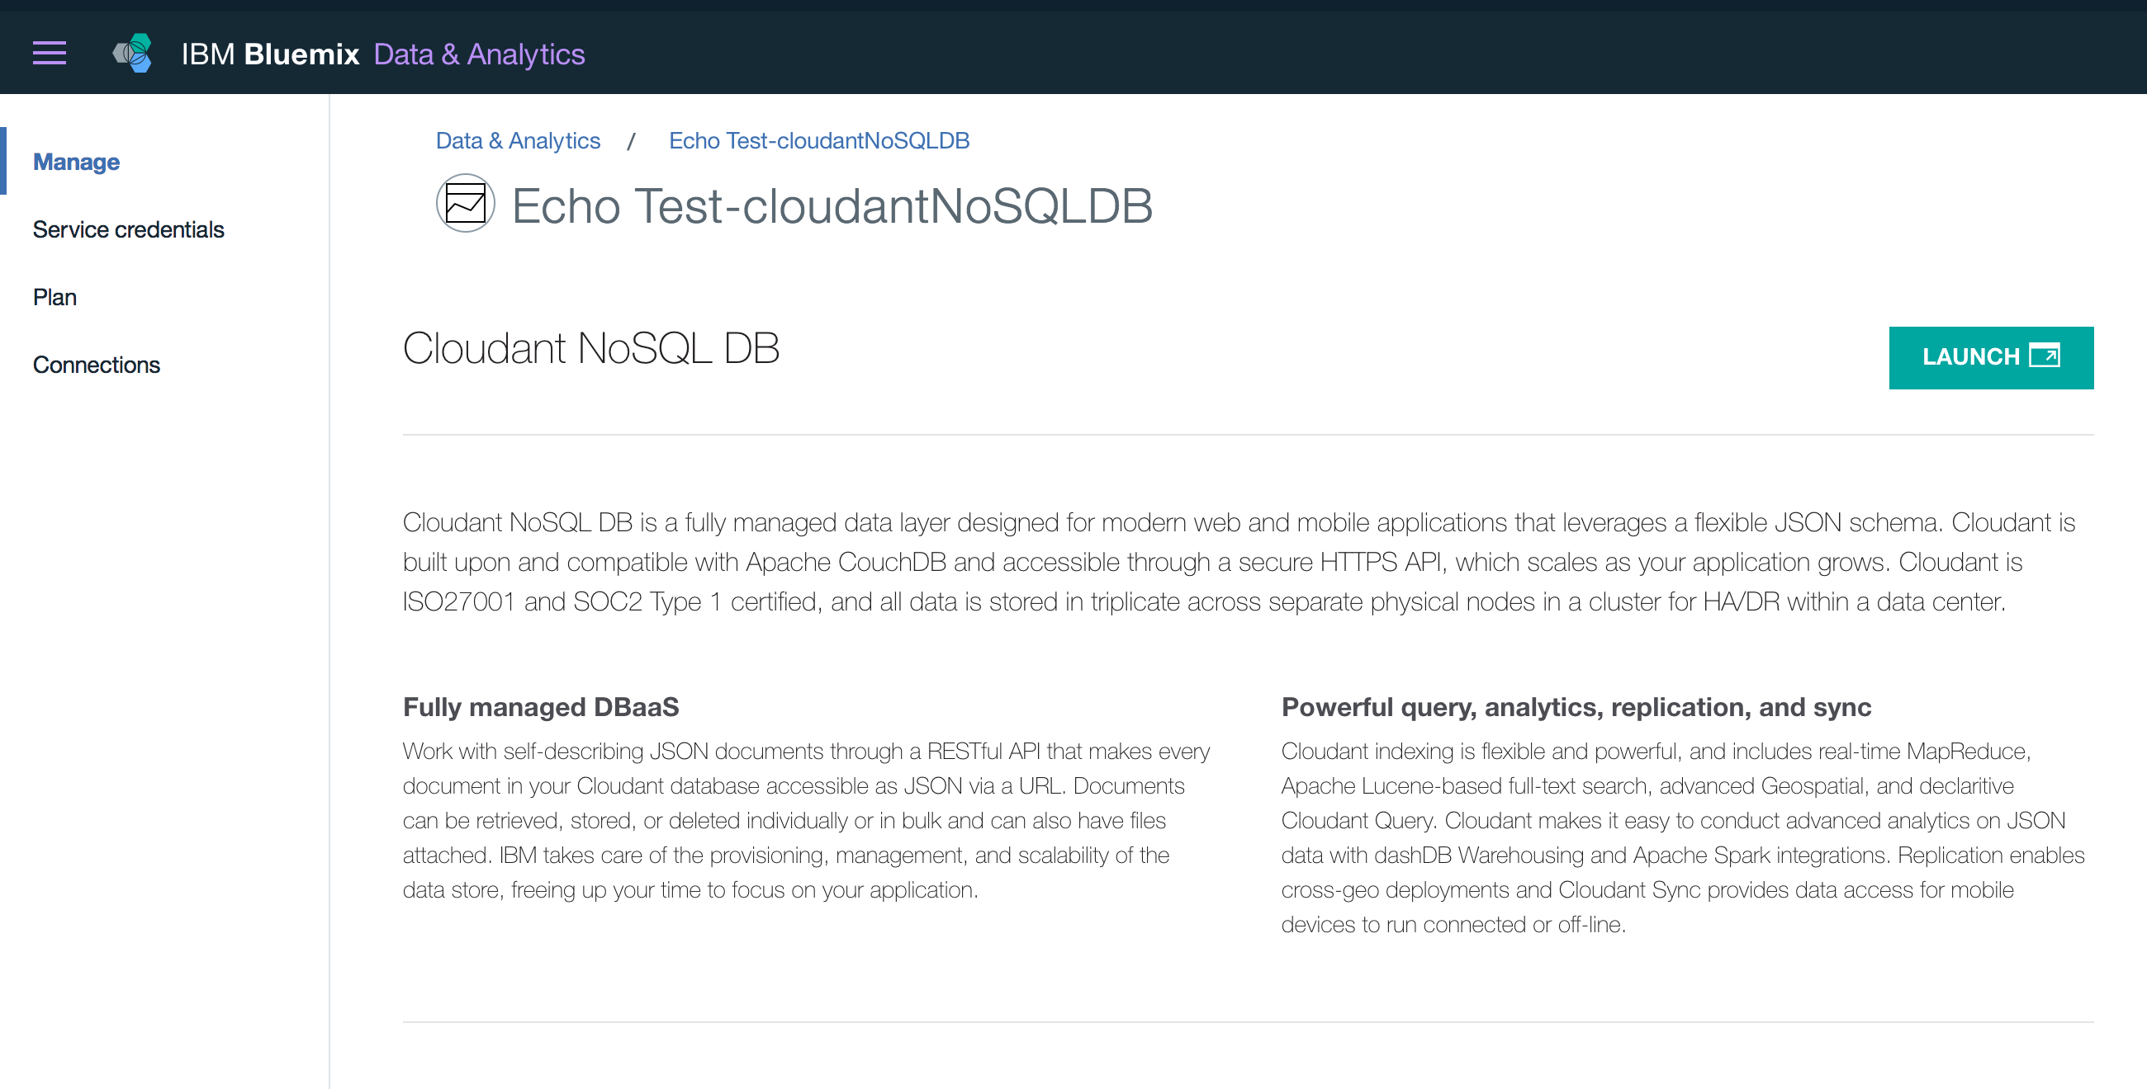
Cloudant data storage

Slide 35
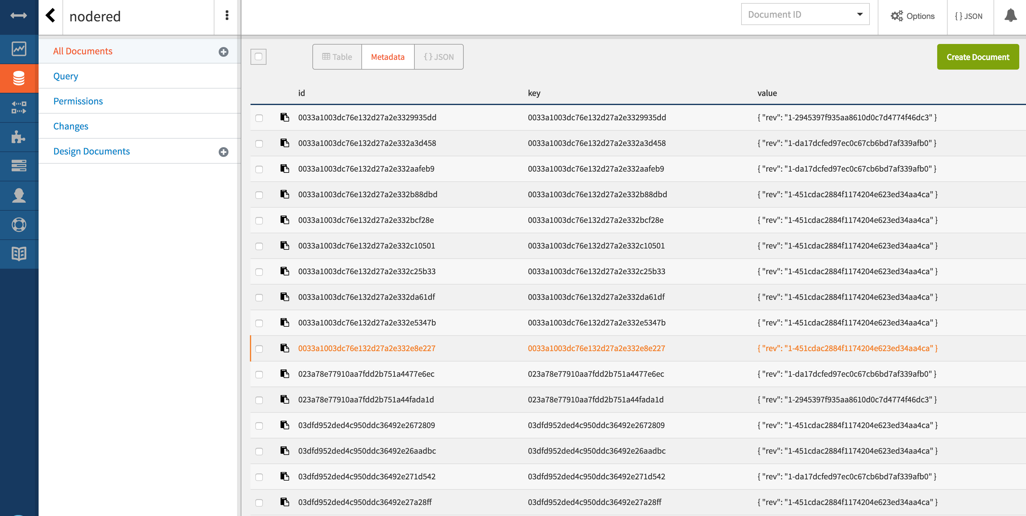
Notes:
Launch

Slide 36
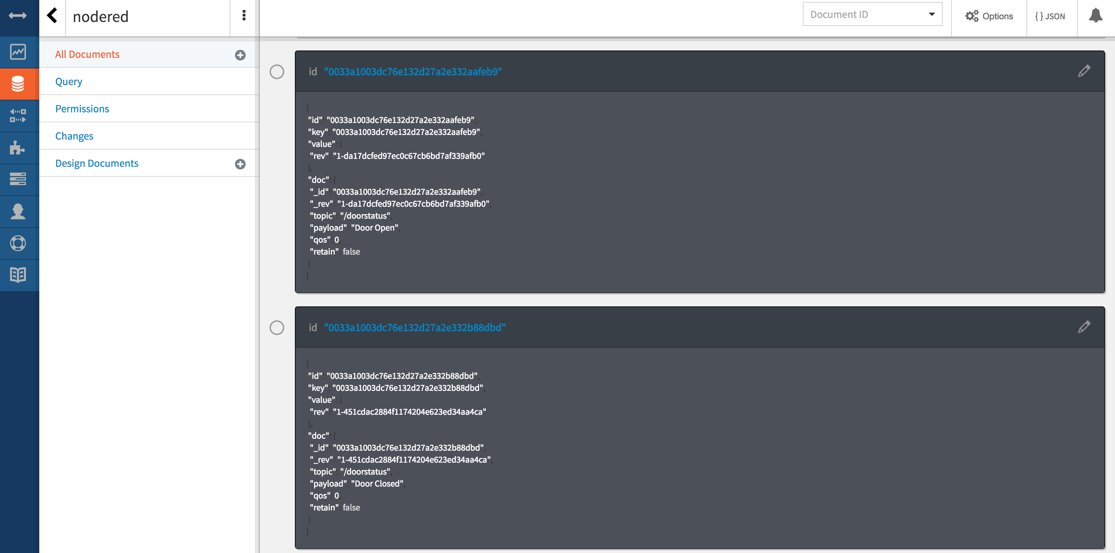

Slide 37
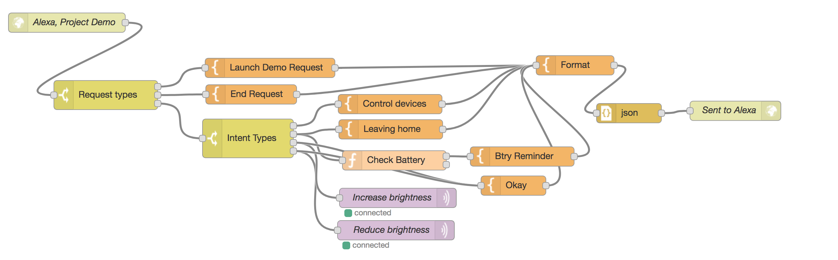
Demo

Slide 38
CONCLUSION
Use of Voice to control IoT devices
Need for effortless updates and connection using Node-Red
Scenario: Brightness control in Edison by changing Regulator value in Node-Red
Control on any device from remote locations
No limitation of distance

Slide 39
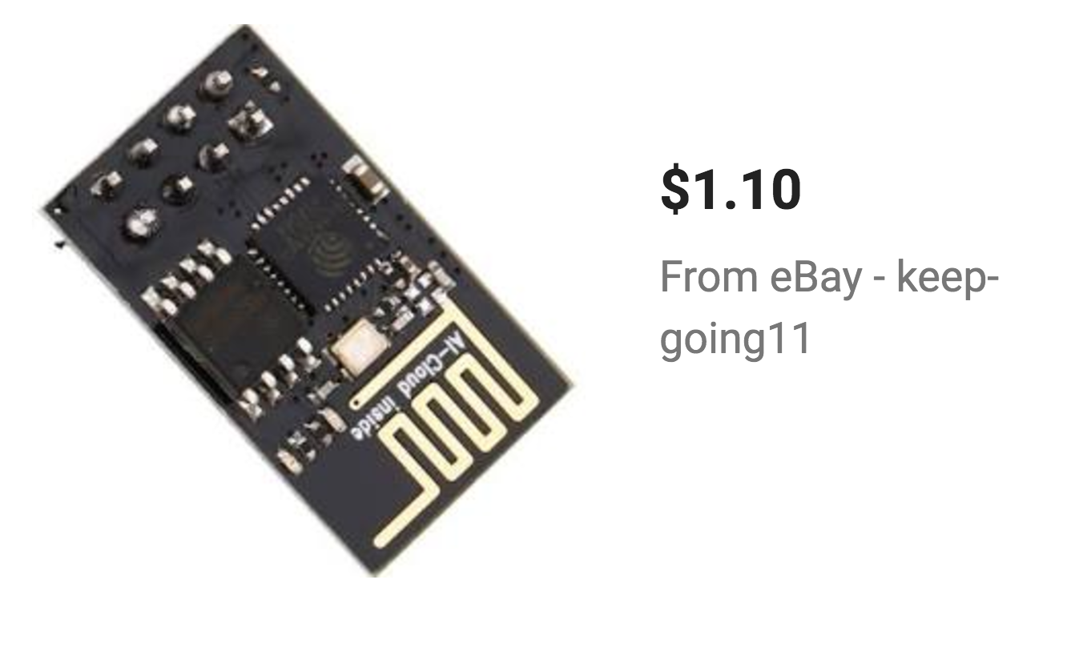
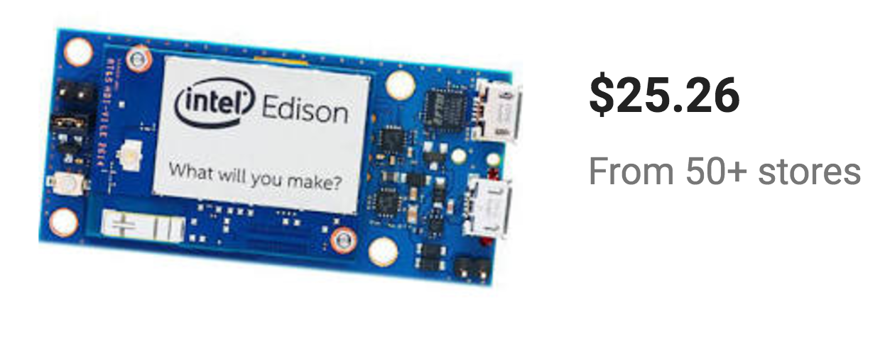
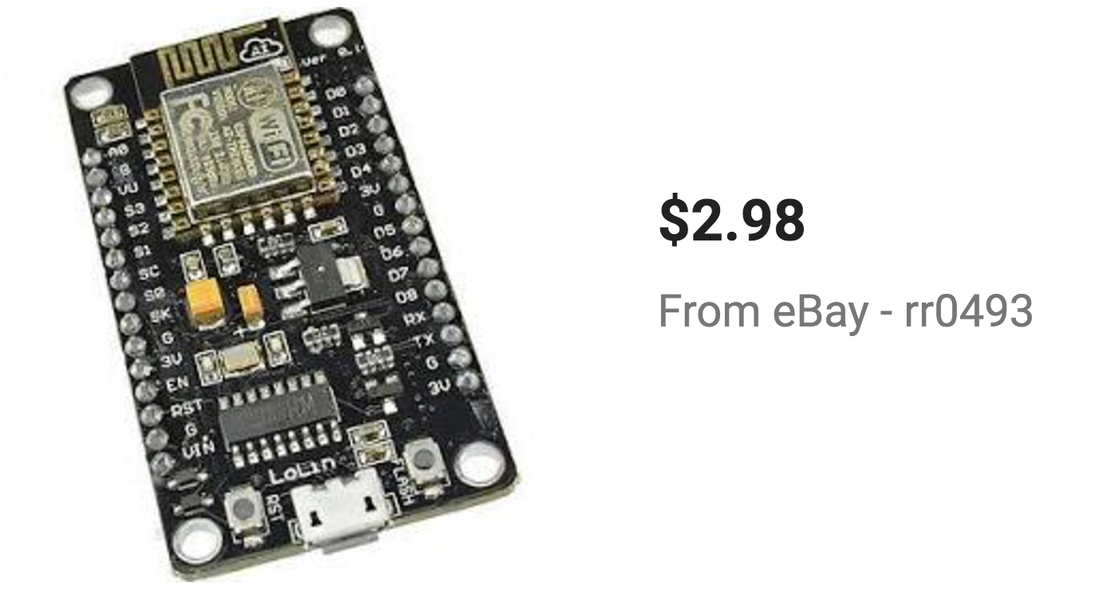
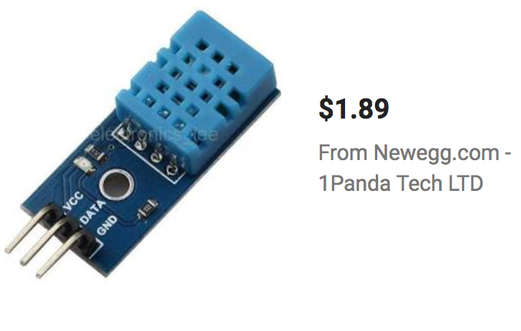
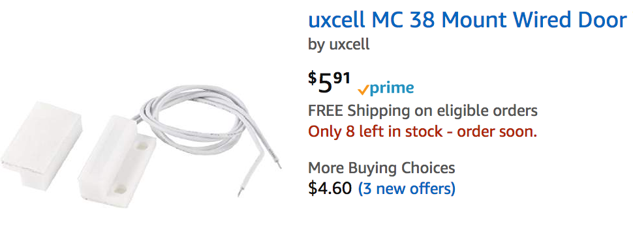
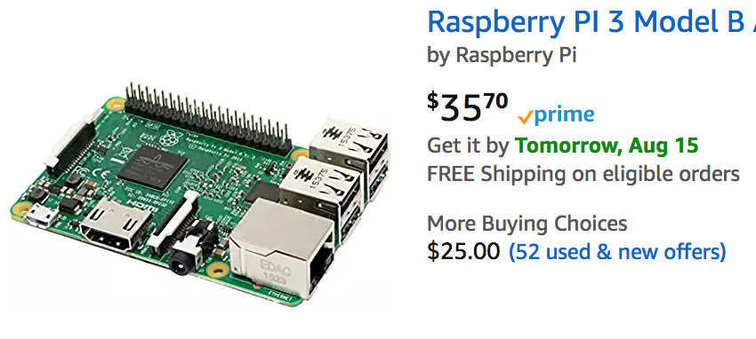
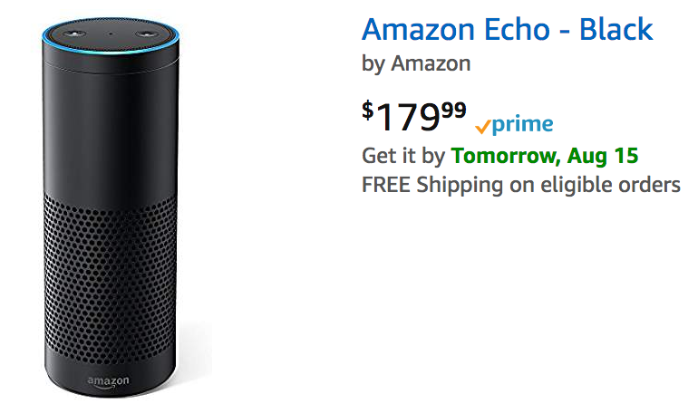
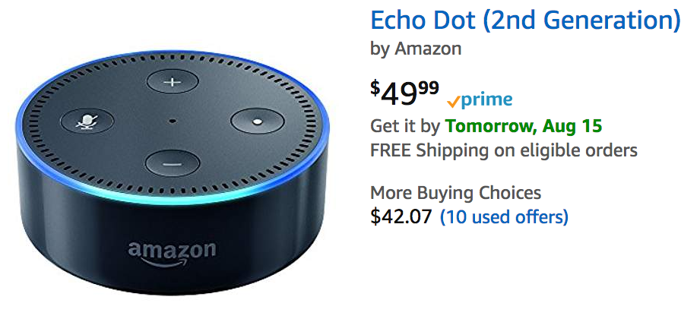
Cost Estimates

Slide 40
Thank You

